Slide 1
GRIFFIN MIDDLE SCHOOL: WHO we are WHAT we’ve done WHERE we’re going
March 30, 2013
For KSU’s BEST EVER ITEC Cohort
By Tracy Efaw

Slide 2
Purpose
The purpose of this presentation is to introduce you to Griffin: who we are, what we’ve done, and where we plan to go.
By using graphic representations of data, you will get to know
Griffin’s children
the history of our achievement
our strengths
our challenges
our plans for the future

Slide 3
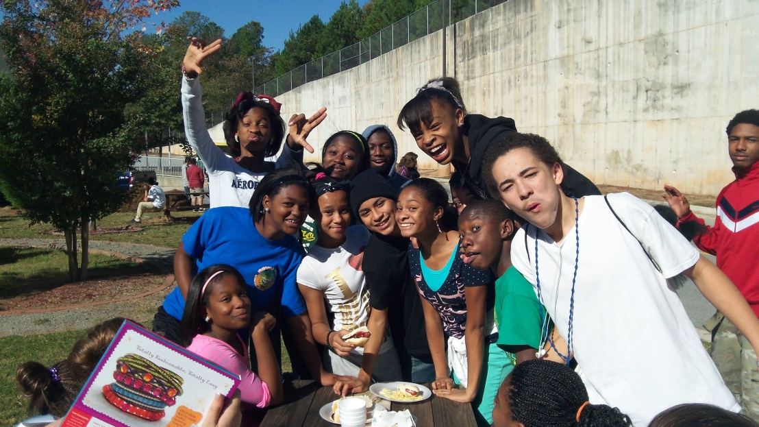
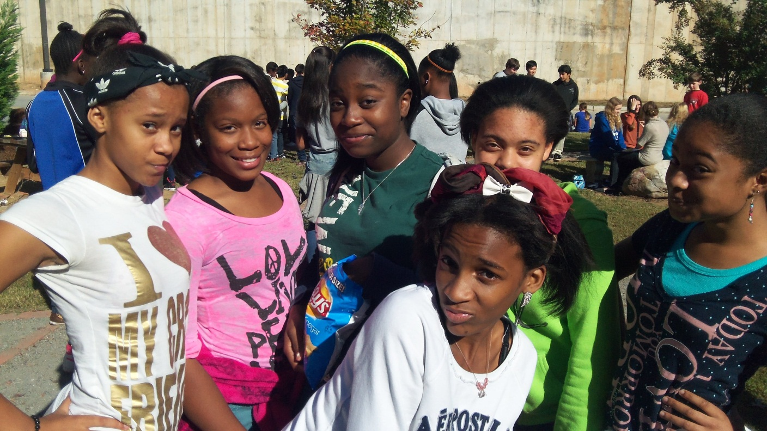
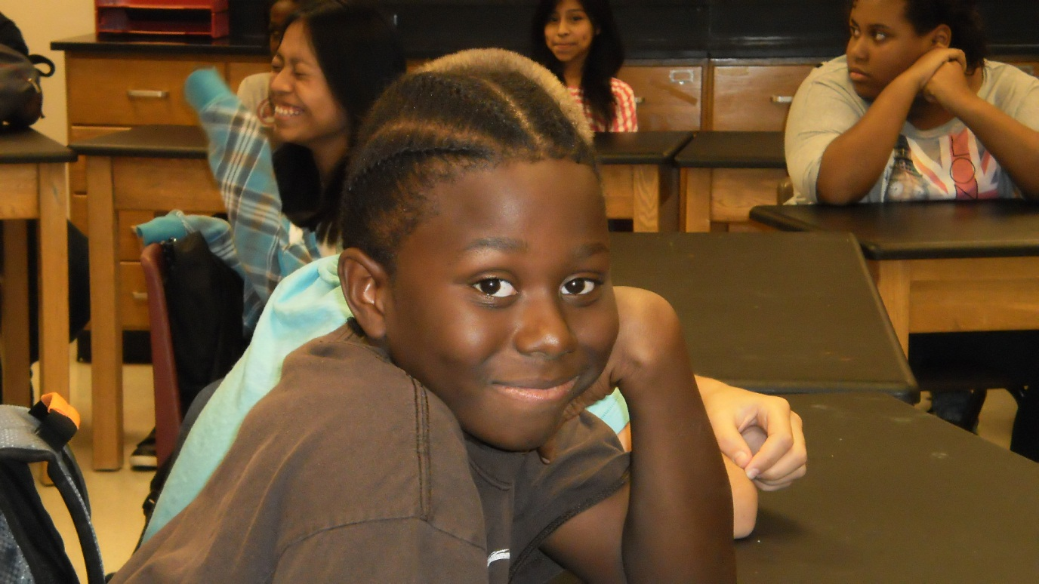
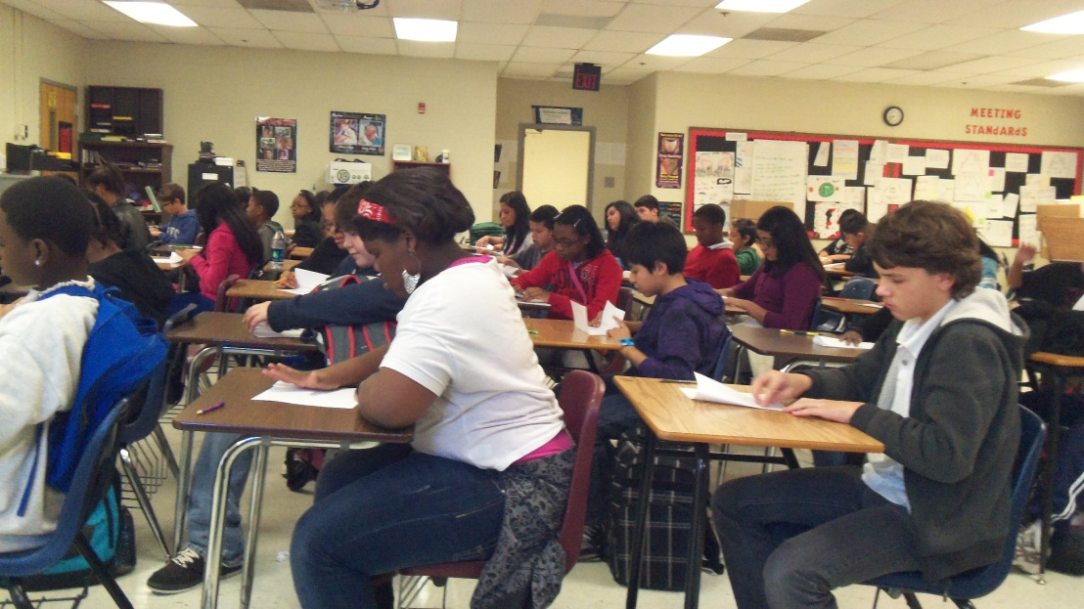
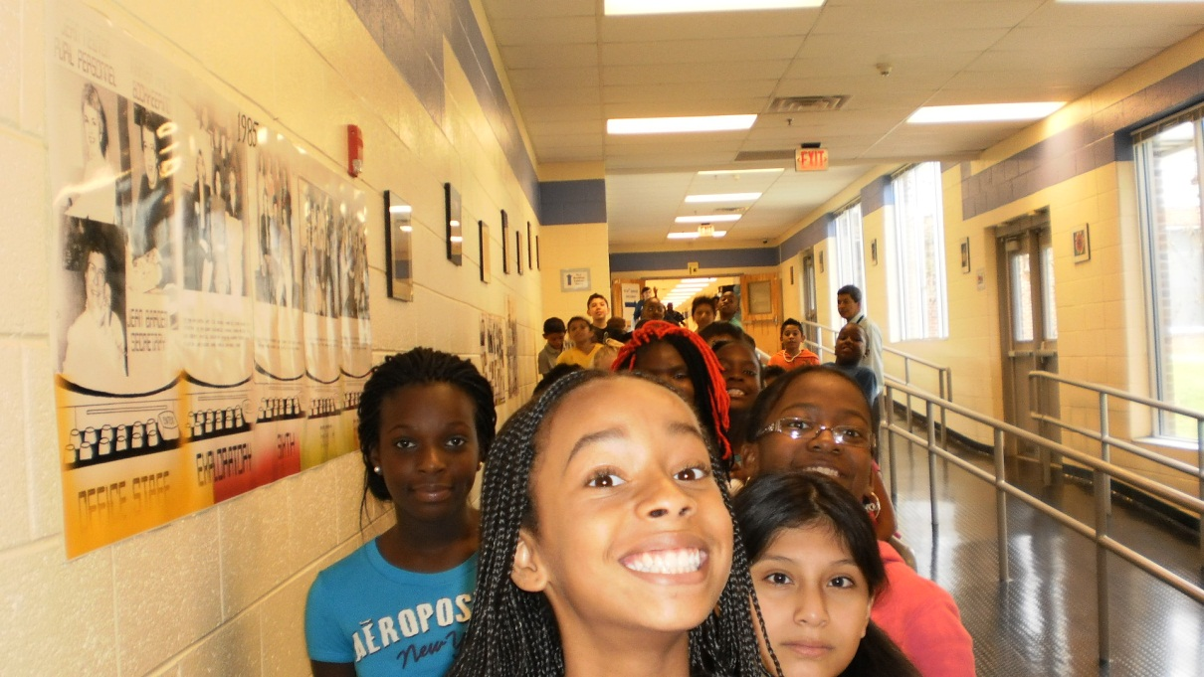
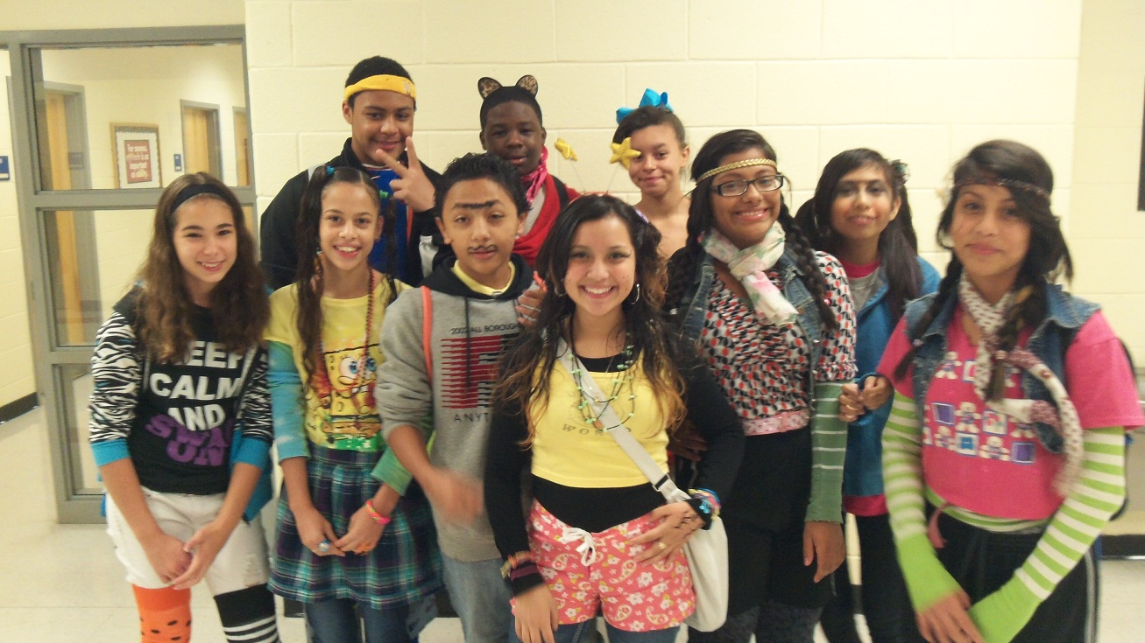
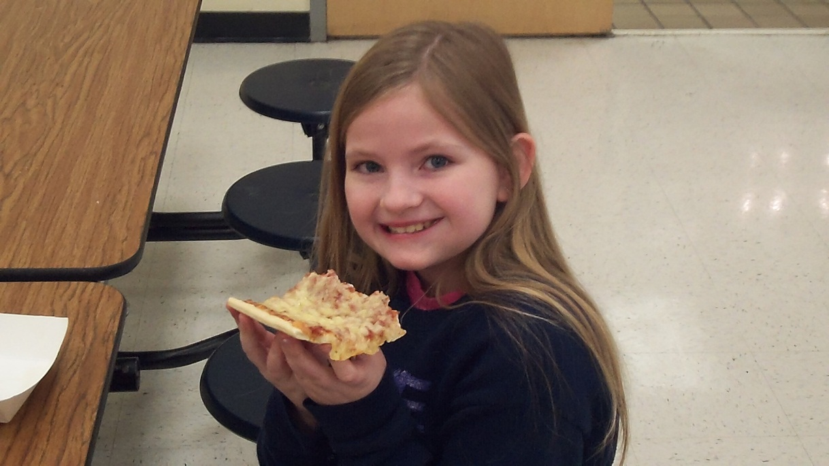
Who are the Griffin Wildcats?
Notes:
Griffin is a Title One school located in the heart of Cobb County. 80% of our students are on Free and Reduced lunch, and because of this, we often deal with a lot of generational poverty, which presents challenges and issues that other schools might not experience on a regular basis. However, our kids are wonderful children who often don’t know what they want or need. They rely on their school environments to teach them way more than just academics. We teach our students about character, responsibility, anger management, and etiquette in addition to the academics for which we are held accountable. Most of us have higher callings to teach at the schools we’ve chosen. Griffin is special and we love our kids….most days.

Slide 4
Notable Historical Tidbits
Griffin suffered six years of “Needs Improvement” status until we made AYP in 2008-09 school year.
In 2008-2009, Griffin was mandated by the state of Georgia to adopt a prescribed curriculum called “America’s Choice.” This was the first year we made AYP.
In 2009-2010, GMS was “state-directed,” meaning someone from the state was working with the principal in managing academics in the school. We made AYP this year as well.

Slide 5
Griffin’s Demographics
Notes:
As you can see from the data, our demographics are typical for a Title I school in this area. Interestingly, our Hispanic and African American students have, and continue to be to two largest populations in our school, followed by the caucasian population at a distant third. As you can see from the graphic, over the past couple of years we have seen a slight increase in our caucasian population and a slight decrease in the Hispanic and African American population. This could be due to the fact that we went from a NI-6 school back in 2007-2008 to making AYP for subsequent years. This is attracting new students to our school who may have gone to other CCSD “choice schools” during our Needs Improvement years.

Slide 6
Griffin’s Enrollment by Year
Number of students
Notes:
Enrollment by grade level is illustrated here, and there is a trend that we see and feel each year of more students in sixth and seventh grades compared to a sudden drop off in 8th grade. Over the past two years, this drop off in 8th grade has resulted in the loss of an allotment for 8th grade Science and Social Studies.

Slide 7
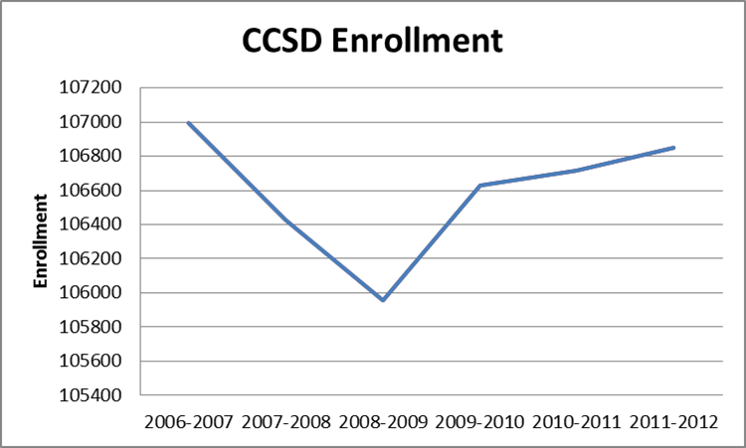
Griffin’s Enrollment
Notes:
It is interesting to note on this slide that our school’s history is reflected somewhat in our enrollment history. Prior to 2008, our school enrollment was on a decline based on our Needs Improvement status. Then in 2008, we instituted a prescribed curriculum based on the state’s recommendation, called America’s Choice. In the 2009-2010 school year, we were state-directed, and made AYP for the first time in six years. As we continued to be successful in our student achievement as measured by AYP each subsequent year, our enrollment numbers have increased. As you can also see, there is a slight correlation between enrollment at GMS and for the whole district. In looking at the district numbers, it is interesting to note that 2008 was the beginning of our recession. This recession may have impacted enrollment numbers district-wide due to people having to leave Cobb County to go elsewhere for work.

Slide 8
6th Grade Student Achievement based on CRCT Results
Please note that these numbers include all subject areas tested (not just Math and ELA) and all subgroups.
Notes:
Each of our grade levels take on personalities of their own. Our sixth grade teachers are generally rule followers and do what they are told. As you can see from the data, while GMS is considerably lower that the district or the state in our results, our trends mirror those of the district and state from one year to the next. Again, please recall that we adopted America’s Choice in 2008 and were state directed in 2009. The last three years on this graphic, our school made AYP.

Slide 9
7th Grade Student Achievement based on CRCT Results
Please note that these numbers include all subject areas tested (not just Math and ELA) and all subgroups.
Notes:
Our seventh grade teachers are generally known for their rebellious natures. Interestingly, this is reflected in their data. Please note the major decline in student achievement while we were state-directed in 2009, and look how 7th grade bounced back once we got rid of our state director!!

Slide 10
8th Grade Student Achievement based on CRCT Results
Please note that these numbers include all subject areas tested (not just Math and ELA) and all subgroups.
Notes:
8th grade teachers are known for being compliant, but very inquisitive. They don’t mind following the rules, but they want answers to questions of feasibility and impact. Note how the numbers increased the year that state director was in school. The state director was able to give the teachers what they needed in the way of knowledge and strategies to be successful.

Slide 11
CRCT Student Achievement by Grade Level Over Time
6th Grade
7th Grade
8th Grade
Notes:
I just thought this was a cool graphic to compare each of the grade levels with each other.

Slide 12
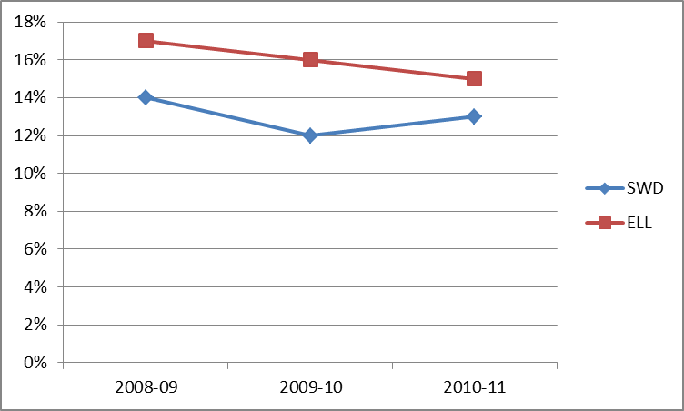
SWD and ELL Enrollment Over Time
Notes:
Our greatest challenge at Griffin comes with managing our SWD and ELL students. Because of the nature of these subgroups, and the sheer numbers of students we have in these subgroups at GMS, every year is a challenge to get these groups to perform. This slide is to simply illustrate how large our numbers are in these subgroups. This will set the stage for the next set of data.

Slide 13
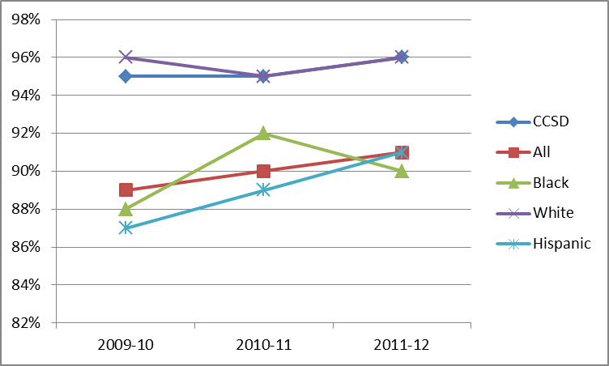
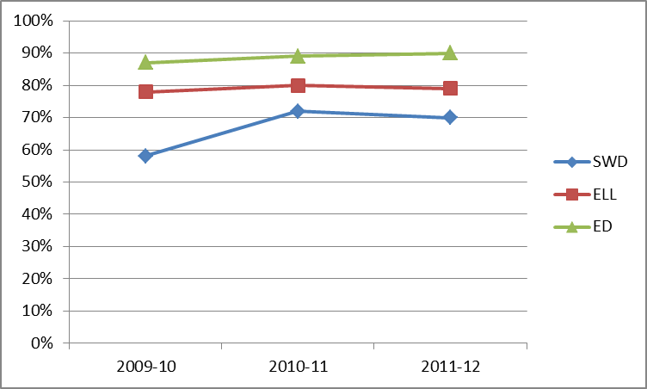
GMS CRCT ELA Data by Subgroups
Notes:
Overall, R/ELA scores have increased a small bit for students in all subgroups except white students. Scores for white students have remained flat over the past three years. Scores for students with disabilities have increased the most (12% increase) even though scores in this category lag farthest behind scores of all students. Specific student groups, especially those who are SWD and ELL, have been targeted for additional support to reduce the achievement gap that currently exists. With Griffin’s current focus on content literacy, an increase in student achievement is expected. The use of two-person instructional teams will allow for greater integration of R/ELA concepts throughout the curriculum in multiple disciplines.

Slide 14
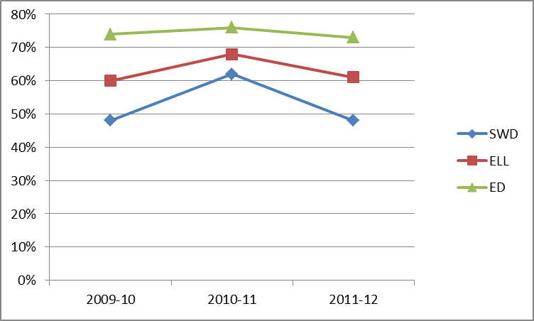
GMS CRCT Math Data by Subgroups
Notes:
Math scores have remained relatively constant over the past three years. Almost all student groups show an achievement gap when compared to Cobb County as a whole. Specific student groups, especially those who are SWD and ELL, have been targeted for additional support to reduce the achievement gap that currently exists. With Griffin’s current focus on math literacy, an increase in student achievement is expected.

Slide 15
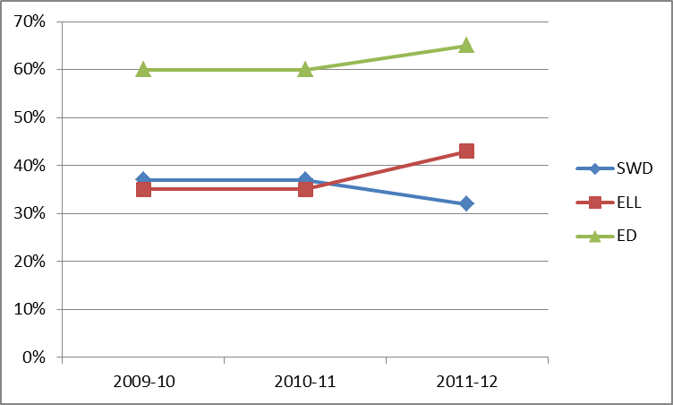
GMS CRCT Science Data by Subgroups
Notes:
Overall, science scores have increased for all student groups except Black and SWD over the past three years. Almost all student groups show an achievement gap when compared to Cobb County as a whole. Specific student groups, especially those who are SWD and ELL, have been targeted for additional support to reduce the achievement gap that currently exists. With Griffin’s current focus on science literacy, an increase in student achievement is expected.

Slide 16
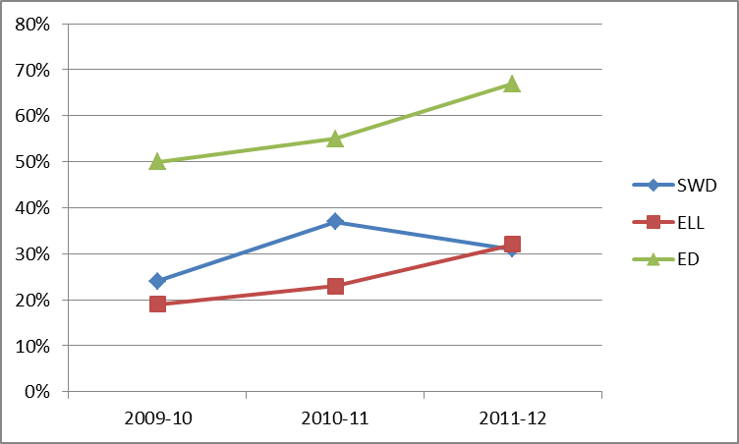
GMS CRCT Social St. Data by Subgroups
Notes:
While Social Studies scores at Griffin continue to lag behind scores of Cobb, significant increases in all student groups are evident. All student groups, except White, show an achievement gap when compared to Cobb County as a whole. Specific student groups, especially those who are SWD and ELL, have been targeted for additional support to reduce the achievement gap that currently exists. With Griffin’s current focus on social studies literacy, an increase in student achievement is expected.

Slide 17
Where We’re Going
Develop Safety Nets that work for our students who are more academically challenged.
Discuss strengths and weaknesses in Data Teams and determine academic strategies for individual students, then track the results.
Hone Data Teams to become more intentional in our data analysis and more practical in the ways we use data.
Monitor successes; learn from failures.

Slide 18
Scenario to Contemplate…
You are the principal at Griffin Middle School. You see your strengths and your challenges. However, every year, you lose more teachers due to reduced allotments, and your instructional budget dwindles each year. Your class sizes have ballooned, and you are asking teachers to do more with less. What kinds of things will you do to increase student achievement in Griffin’s weakest areas while maintaining the successes?

