Slide 1
Integrating Technology to Promote Improved Academic Achievement
By Tracy Efaw
Notes:
Today I would like to share with you some really cool ways that we can Integrate Technology to Promote Improved Academic Achievement.

Slide 2
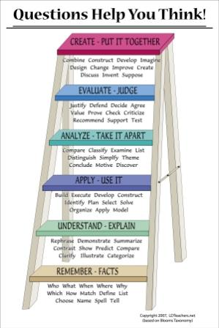
Technology Enhances the Standards
Notes:
Before we begin, it is important to understand that the goal of successful technology integration isn’t about using technology for its own sake. The real goal of technology is to enhance the learning that is already taking place in the classroom, thus engaging students in authentic learning tasks that result in higher student achievement. No longer should we, as teachers, work on fitting the task to the technology. Better, let’s work together to fit the technology to the task, and let’s ensure that the tasks we choose push kids to more complex, higher order thinking. Technology is the key to this kind of success!! When we can integrate technology into lessons that are already brimming over with depth and complexity, we begin to climb the LoTi ladder of engaged student learning ever higher!

Slide 3
Standards and Elements
The student demonstrates competence in a variety of genres.
Engages reader
Reveals the significance of the writer’s attitude about a topic.
Creates writer’s voice
Creates an organizing structure appropriate to needs, values, and interests of a specified audience.
Notes:
Let’s take a look at the writing standard ELA8W2, “The Student demonstrates competence in a variety of genres. Look at the elements. You decide. Which do you think would be better: having the same audience as the 800 times the students have tackled these elements in the past…which would, of course, be US…the teachers. OR…how about encouraging students to connect with a broader, even global audience by connecting them with ePals at www.ePals.com? Here, students can connect with other students and teachers and get feedback about whether or not they were successful at being engaging. By having an authentic audience, our students care more about their final product, because their writing becomes an extension of their own personality. Doesn’t that completely redefine things like writer’s voice? Tone? Doesn’t this kind of technology prompt students to think more deeply about their REAL LIFE audience? No longer do we need to play “make believe.” Students can publish their writing on line NOW and get feedback from a variety of users.

Slide 4
Imagine the Possibilities!
www.ePals.com
Notes:
Imagine the possibilities!

Slide 5
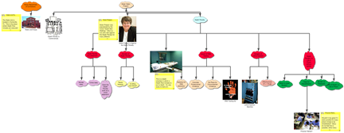
Need some “Inspiration”???
III. Death Penalty
A. Dangers of Lethal Injection
1. Effectiveness of L.I. Drugs
2. Lethal Injection Machine
B. Morality of Death Penalty
1. Is killing ever Moral?
2. Racial Inequity
C. Death Penalty as a Deterrent
1. Does the Death Penalty work as a crime deterrent?
2. Crime rates
3. Murder rates
D. Death Penalty v.s. Life in Prison without parole
1. Cost of Death v.s. Life in Prison
2. Burden on Taxpayers
Notes:
Another powerful strategy to help students conceptualize their writing in meaningful ways is the idea of concept mapping. Concept mapping, like Inspiration or Kidspiration helps students create visual graphics and outlines to assist in planning their writing. What a wonderful way to show students how formal outlines work from a simple brainstorm. Many students get to experience their own EUREKA! moments when they watch their web of ideas convert into an outline from which they can very easily compose the rough draft of their essays. Also, I have found that the process of students investing time in completing a brainstorming activity in its entirety helps build confidence in students that they CAN, indeed, succeed in writing meaningful essays.

Slide 6
Research Hum-Drums???
The student produces writing from research that
Poses relevant and tightly drawn questions about a topic.
Engages the reader
Conveys accurate perspectives
Uses a variety of primary and secondary sources
Documents resources (bibliography)
Notes:
Are you bored with your research unit? Worse yet, are your students bored? Tired of the same old “sit and get” research with a culminating PowerPoint explication? If you’re sick of it, so are your students!! How about giving them something real to research? Find them real people to report their research to, and look into technology that will enhance this experience.

Slide 7
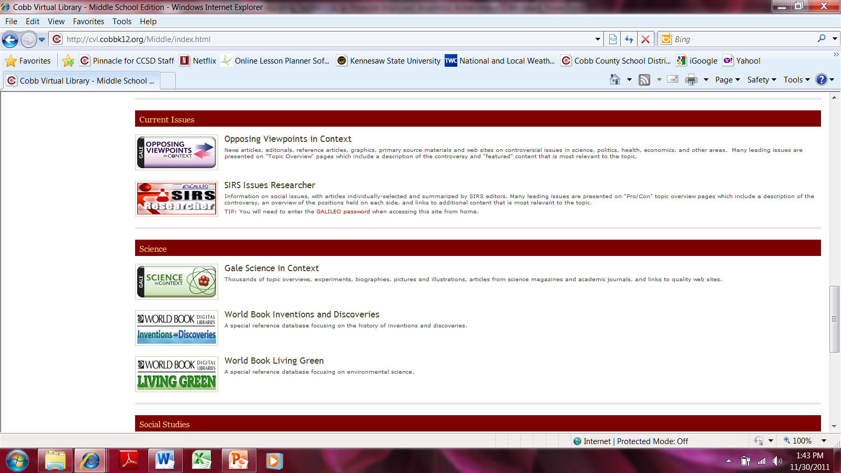
Cobb Virtual Library
Notes:
Cobb Virtual Library is an excellent place to start research for those who need to gather information. From the wonderful databases of magazine and newspaper articles to the on-line encyclopedias at the fingertips of all our students, research has become a real snap!

Slide 8
Research Hum-Drums
www.citationmachine.net
Notes:
Even documenting those primary and secondary sources becomes a snap using Citation Machine. Now students simply plug in their vital information and the program arranges the information and the formatting exactly how it’s supposed to be with a few clicks of the finger!

Slide 9
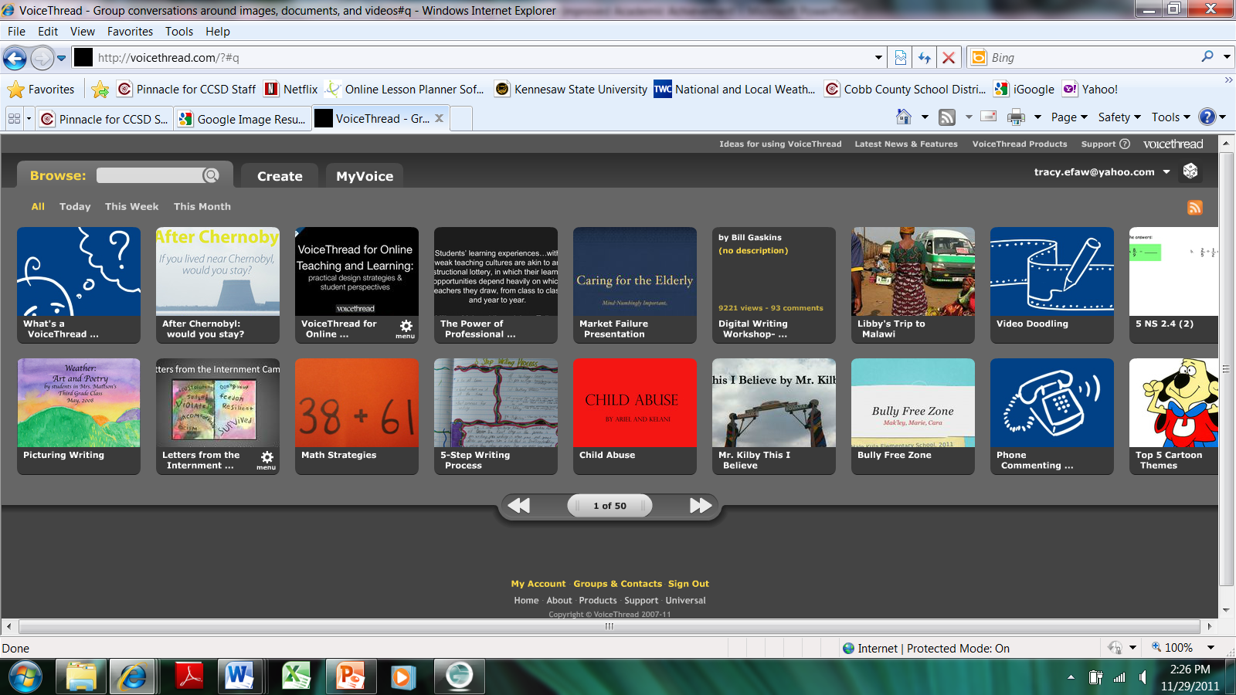
Spicing up your Research Unit
www.voicethread.com
Notes:
Your students will also appreciate new, innovative ways to show off their research once they have synthesized it. The following few slides show some new ideas for students to try. Take voicethread, for example. Voicethread is a internet-based technology medium in which students can display their research via video, audio, PowerPoint, Prezi, or even just text. Not only can your students present their information, but other people can respond back in the same variety of ways. Because students are performing with meaningful content for an authentic audience, utilizing voicethread ensures a clear increase in the LoTi levels for engaged learning.

Slide 10
Spicing up your Research Unit
www.prezi.com
Notes:
Prezis are another way to allow students to use their creativity to display their research. There are a multitude of complexities within the Prezi that students can utilize, and they love it! It’s like a PowerPoint on steroids! When you go to www.prezi.com, there is a very simple tutorial that will show you the many ways you can enhance your presentations. Just follow the simple directions and transform your own teacher presentations to your students!

Slide 11
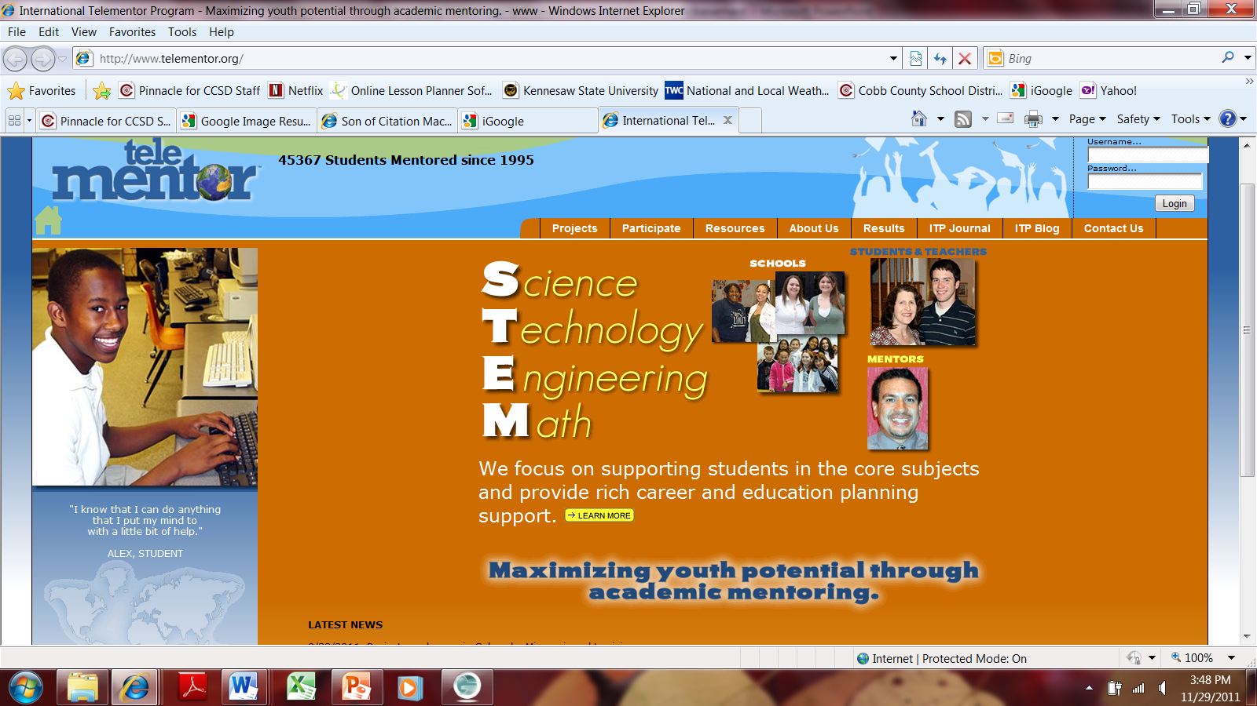
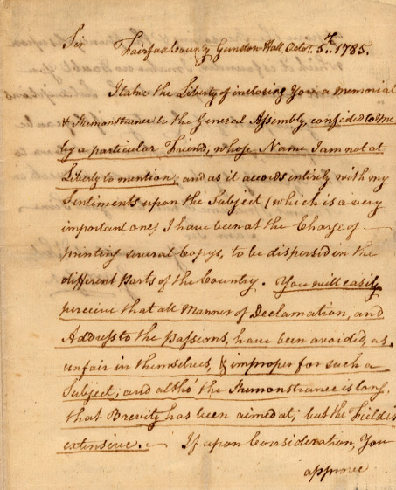
Spicing up your Research Unit
Notes:
Those old primary sources can get pretty dry and boring, too. How many times do we have to refer to the US Constitution or the Bill of Rights for crying out loud!? What about connecting with a contemporary expert in the field with whom students can “chat” and question? www.telementor.org is an excellent resource for topics related to science, technology, engineering, and math. Students can make connections with actual people in the field and get primary source feedback for their research. Additionally, this is an international website which encourages multidisciplinary work from students, so feedback can come from a variety of global perspectives, deepening the understanding and complexity for our students and ensuring higher levels of engaged learning.

Slide 12
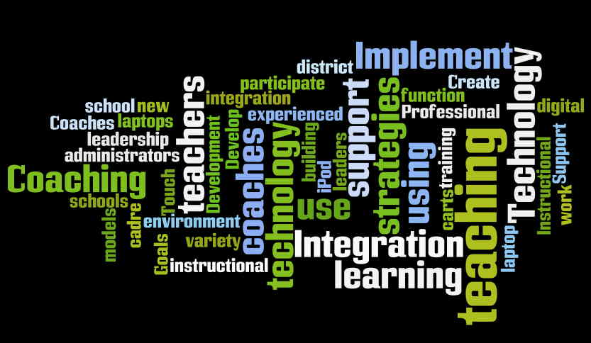
Spicing up your Research Unit
www.wordle.net
Notes:
Finally, if you want to do a quick check on your written research report, and you need a quick reference to make sure that your themes are on-track, copy and paste your research into Wordle.net. This will help you see what your emphasis was in your writing. It is also a great place to create vocabulary walls for your students.

Slide 13
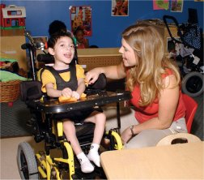
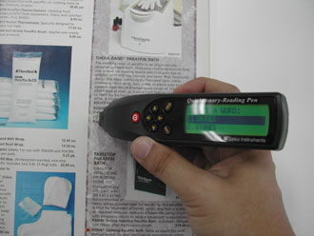
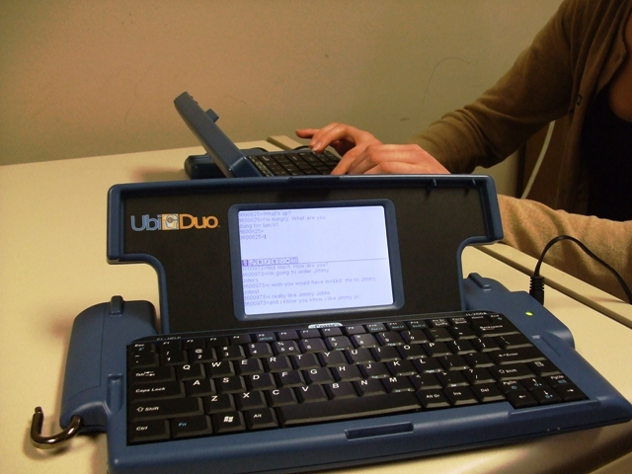
Smart pens
Notes:
One more point that is often overlooked but very, very important is ensuring that our Special Needs students have equitable access to technology. This might mean looking for alternatives for those who are hearing or sight-impaired. Much depends upon what the district already has in place, but there are some less expensive alternatives out there that could also benefit Special Needs students.

Slide 14
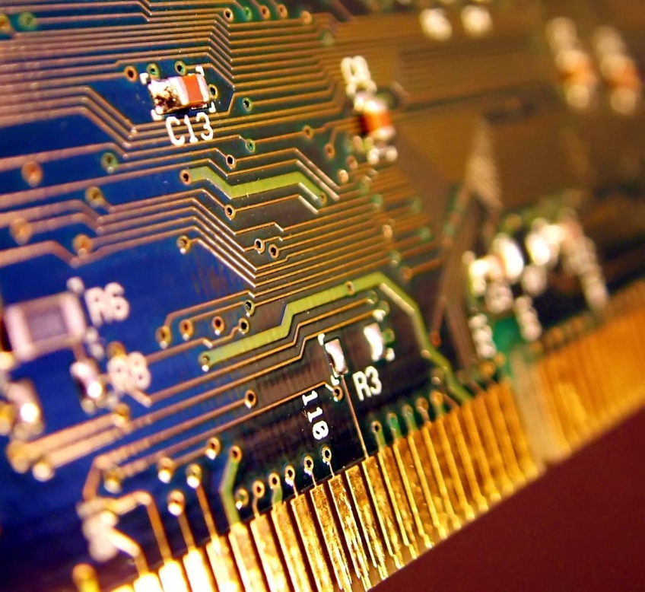
Technology Abounds!!
Notes:
Technology abounds. This is such a minute representation of the amazing innovations that are at our fingertips now. Take a little time each day to research the plethora of exciting alternatives for yourself and for your students. Find fun and innovative ways to embed this technology into authentic learning opportunities for students. Enjoy their engagement. Don’t allow yourself to be left in the dust of ignorance.

Slide 15
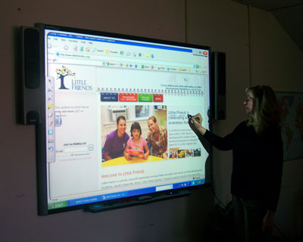
EMBRACE the VISION!!
Notes:
Embrace the vision!

