Slide 1
“D.R.A.W.” for Literacy Using “Blackboard”
Tracy Efaw
Capstone Presentation
Kennesaw State University
http://youtu.be/YmwwrGV_aiE

Slide 2
What is D.R.A.W.?
Discussion
Reading
And
Writing
D.R.A.W. is the strategy GMS uses to increase student achievement by targeting literacy skills in every content area. Blackboard supports D.R.A.W. in many ways.

Slide 3
Introducing GMS’s Blackboard Learning Community

Slide 4
Blackboard Supports Teachers in Many Ways
Library of Resources
Websites
Leveled Articles
Strategies
Units of Study
Teacher Features
Collaboration through Grade level Wikis
Lesson Plans
Data Team Meeting Minutes
Interdisciplinary Planning and sharing of ideas

Slide 5
The NEED: 1) Bridging Common Core Achievement Gap”
Literacy competence across all content areas is critical to a student’s success with Common Core rigor.
Practicing content literacy strategies will help bridge the gap between what students can do now and what is expected of them with the Common Core curriculum.
Blackboard is the mechanism to give teachers what they need for resources and collaboration.

Slide 6
Introducing Blackboard’s Common Core Resources

Slide 7
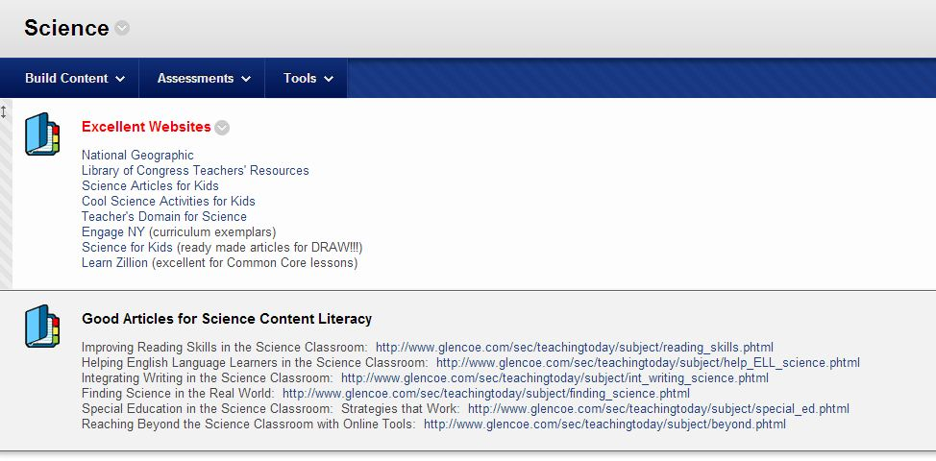

Slide 8
The NEED: 2) Providing a Place for Literacy Collaboration
Teachers can share lesson plans and ideas related to school-wide literacy initiative
Teachers can discuss planning issues
Teachers can share strategies for best practices in literacy.

Slide 9
Introducing Blackboard’s D.R.A.W. Initiative Resources

Slide 10
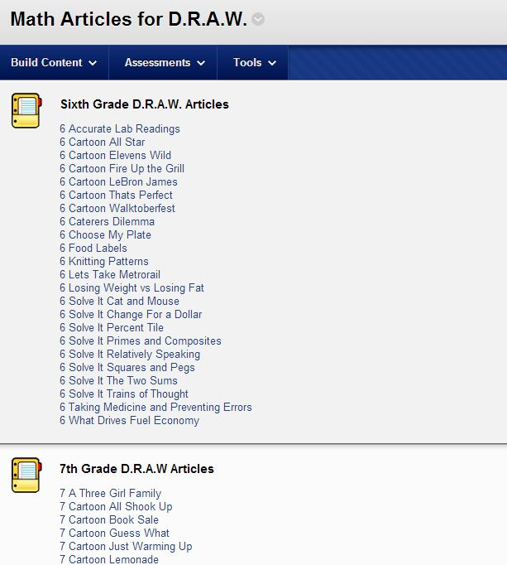

Slide 11
The NEED: 3) Providing a Place for Data Dialogue

Slide 12
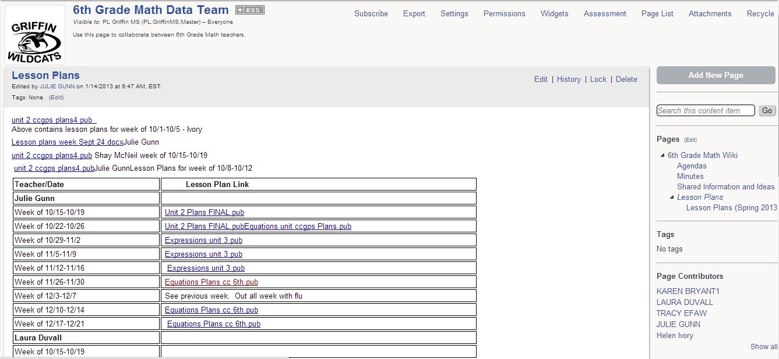

Slide 13
Program Celebrations for Teachers
Teachers in every content area are teaching literacy strategies weekly in conjunction with regular curriculum.
Teachers receive continued professional development training in content literacy related to new Common Core Curriculum.
Reading Comprehension Strategies
Writing/Expression Strategies
Depth of Knowledge Training

Slide 14
Program Impact
Student benchmark scores for the first semester exceeded district averages.
Griffin increased our 8th Grade Writing Scores by 2% overall, and showed growth in every domain
Griffin’s (preliminary) CRCT scores reflect gains in every content area
2.1% in ELA
2.0% in Math
6.9% in Science
9.5% in Social Studies

Slide 15
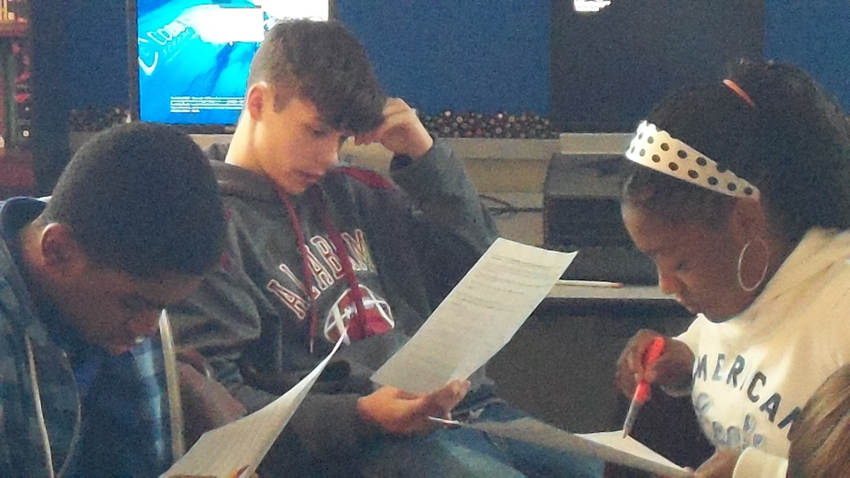
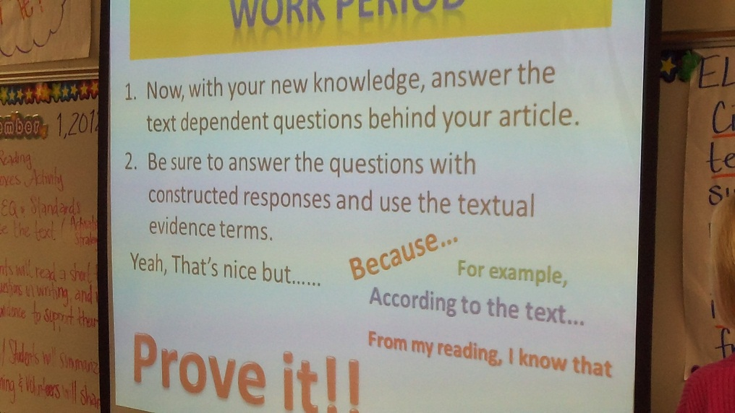
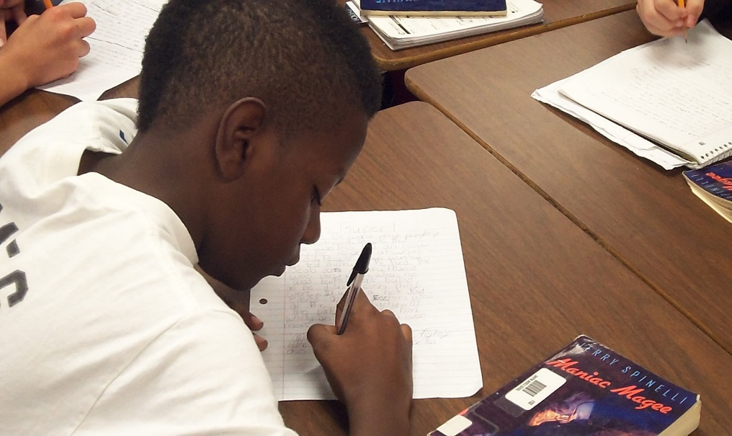
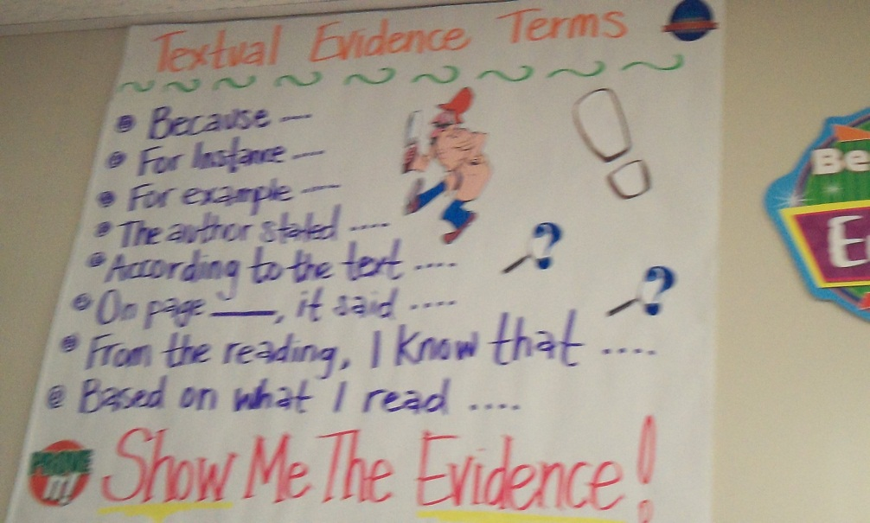
D.R.A.W. In Action

Slide 16
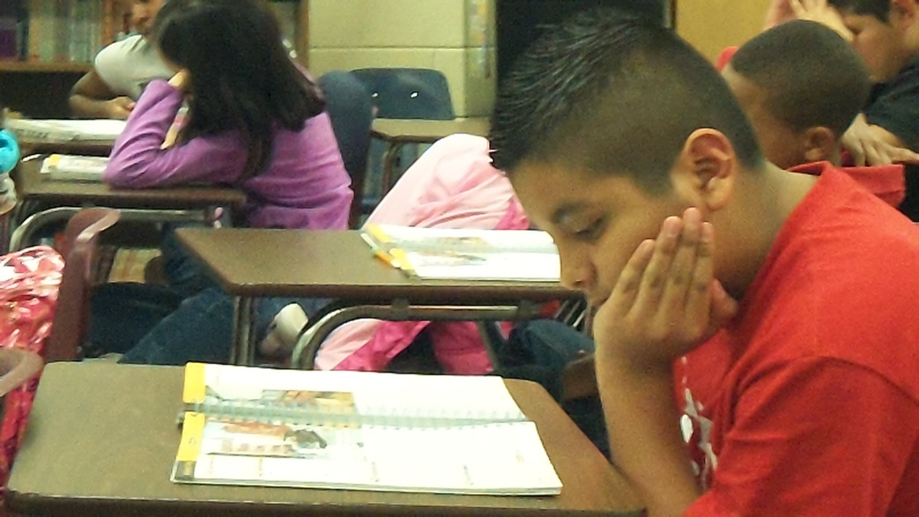
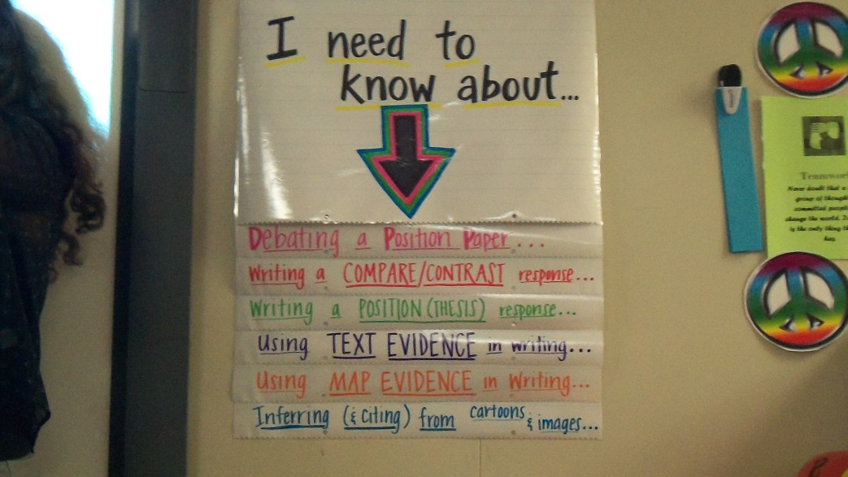
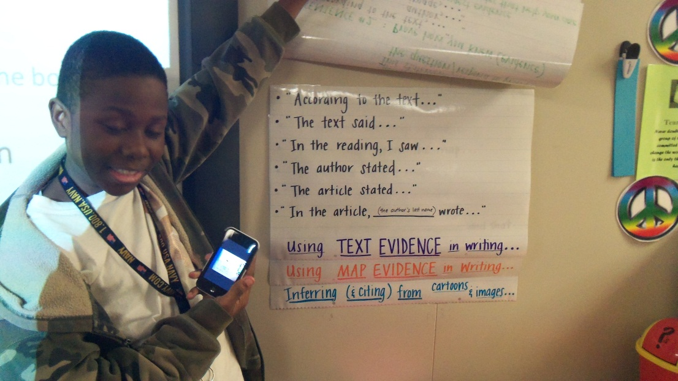
D.R.A.W. In Action

Slide 17
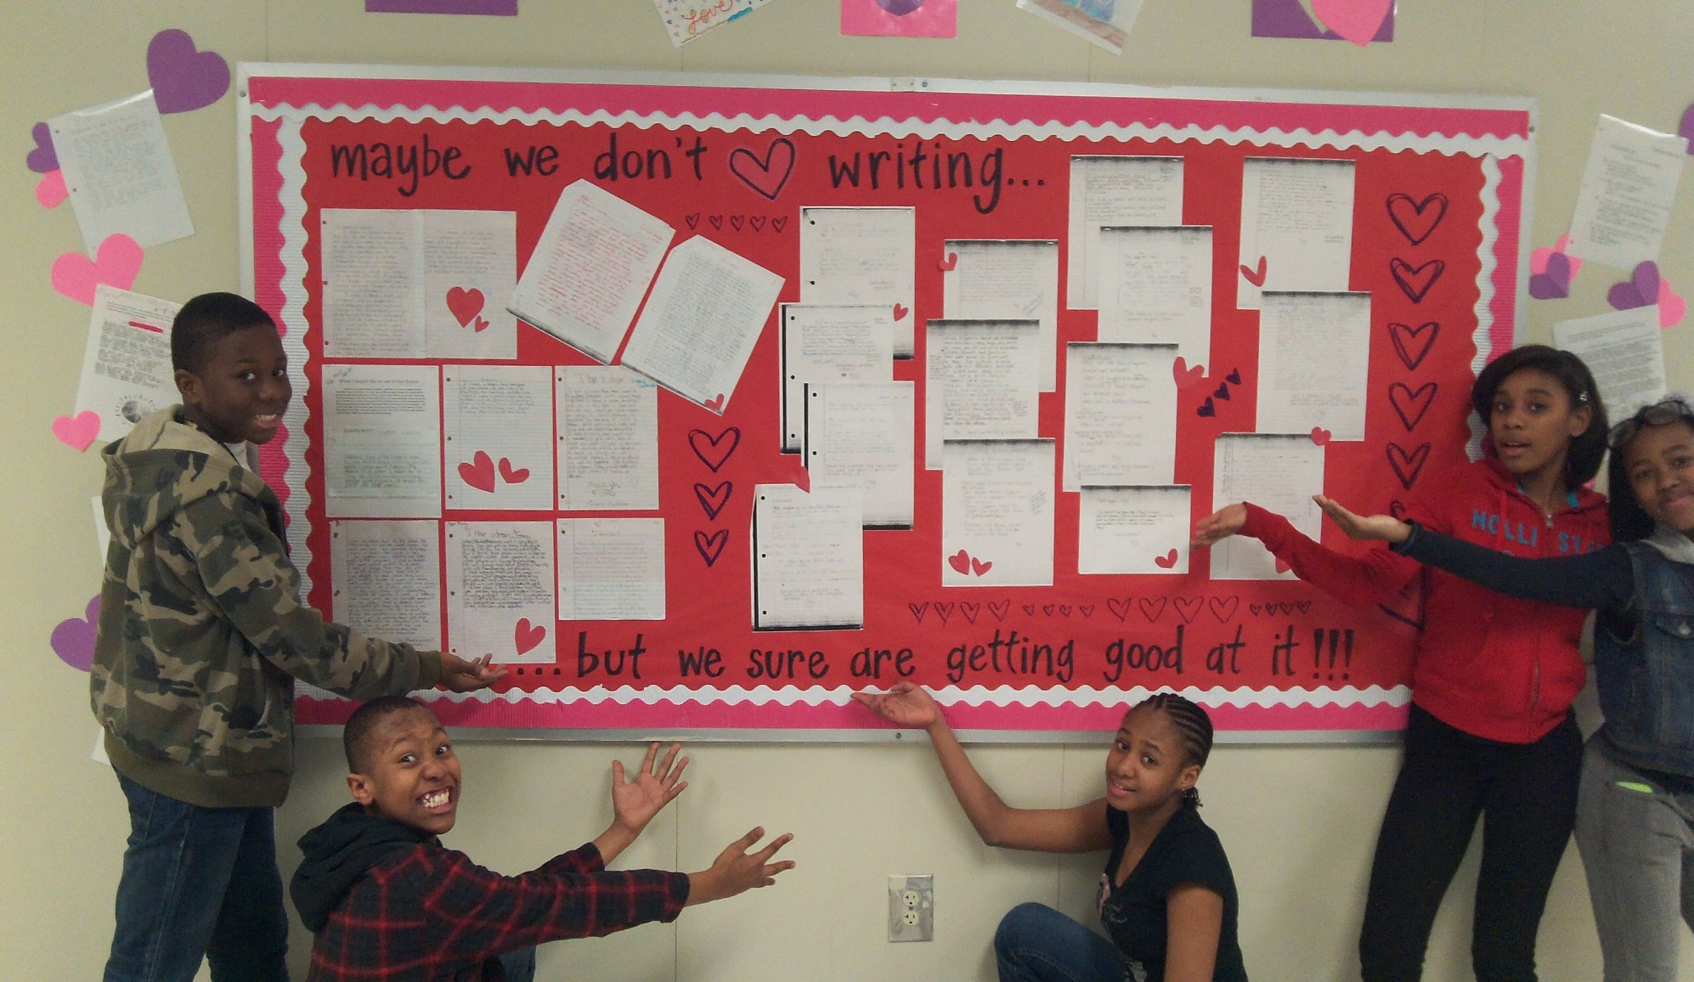
D.R.A.W. In Action

Slide 18
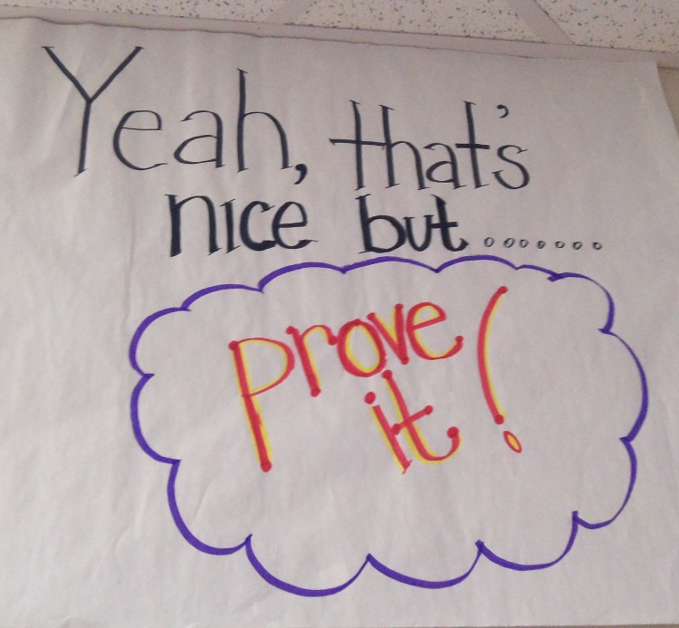
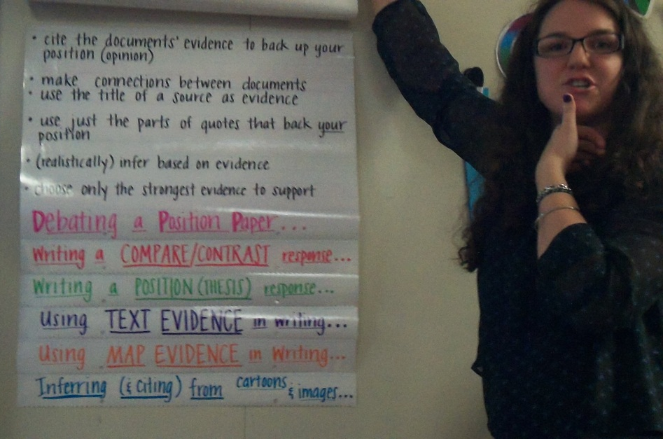
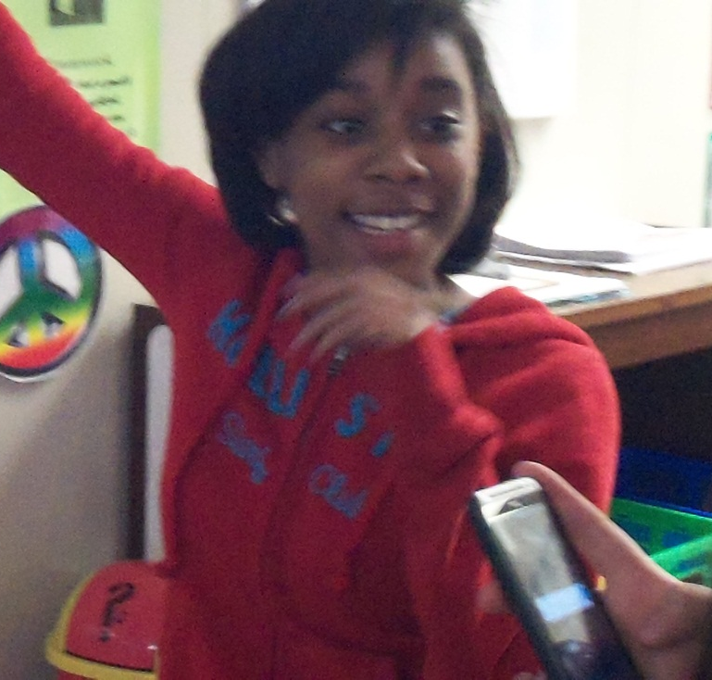
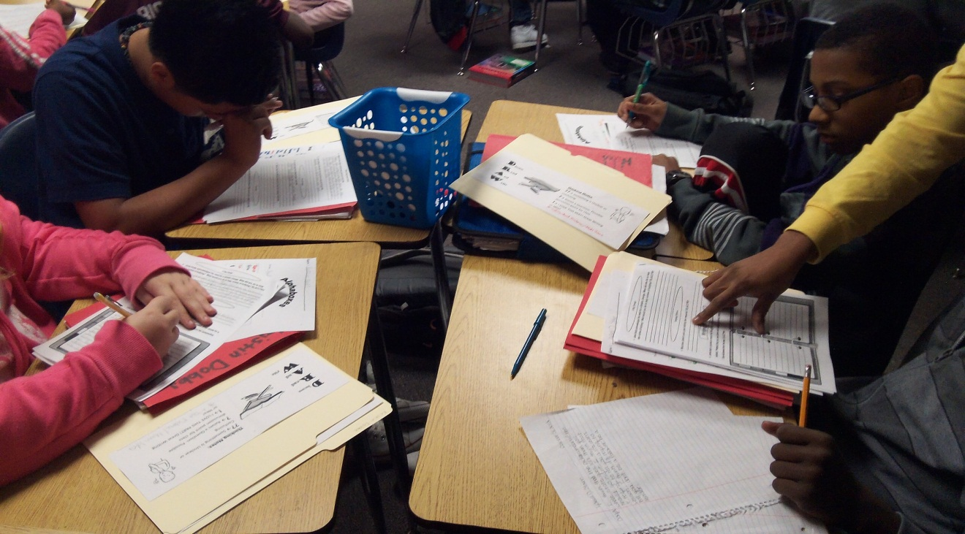
D.R.A.W. In Action

Slide 19
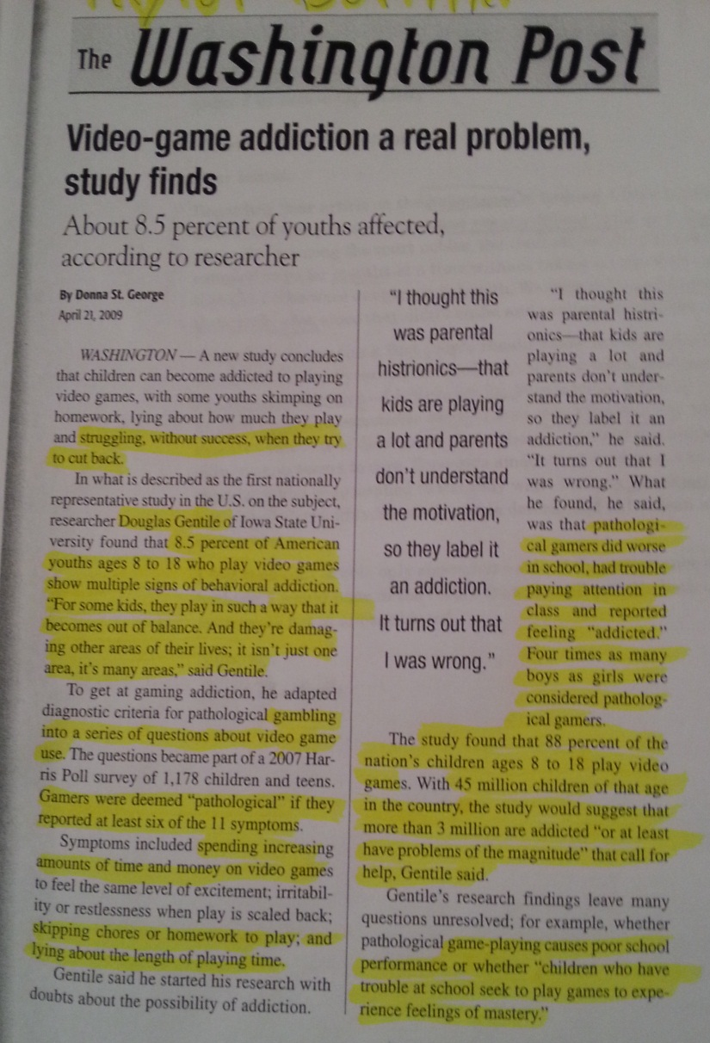
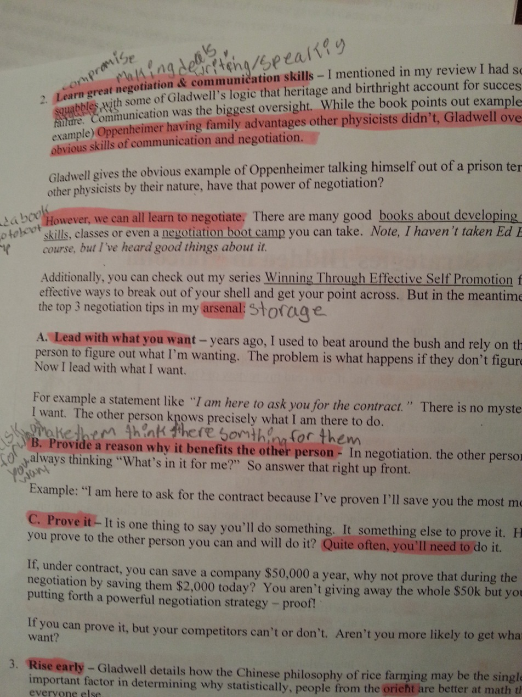
Student Work
From This…
To This!!

Slide 20
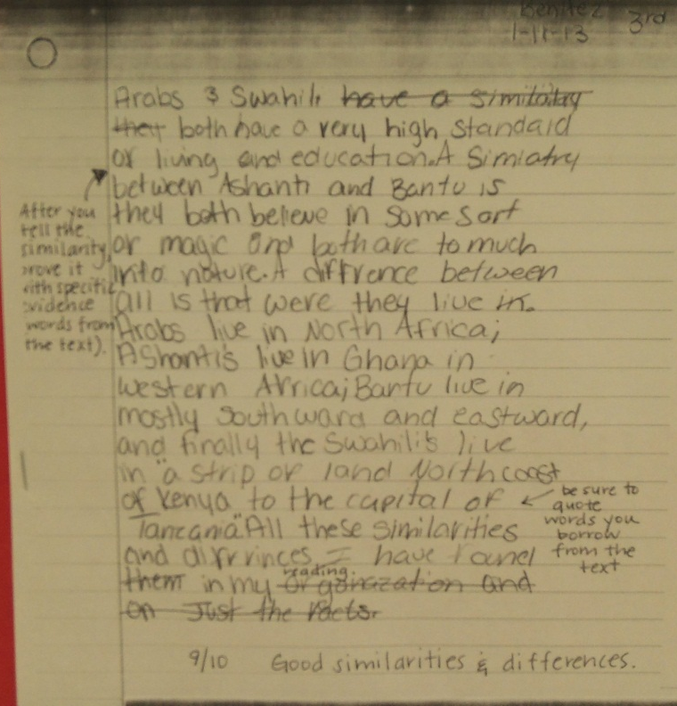
Student Work

Slide 21
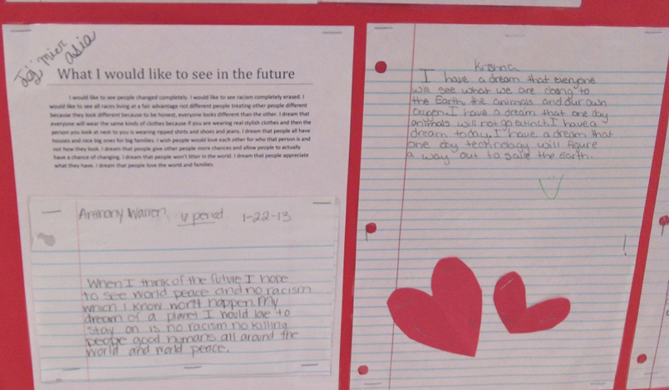
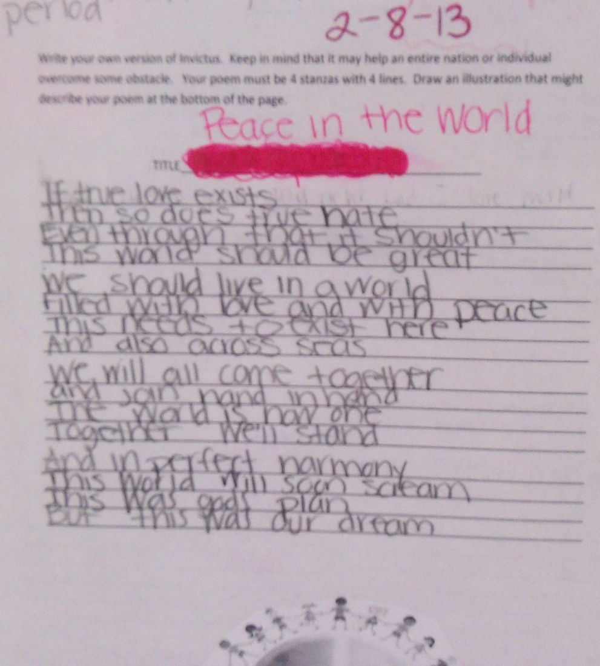
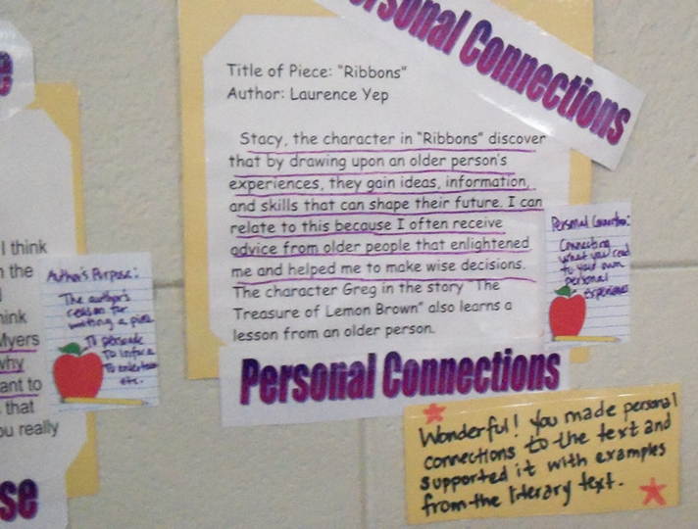
Student Work

Slide 22
www.kennesaw.edu/iteceds
www.kennesaw.edu/itecmed
www.tinyurl.com/KSU-ItecDegrees

